Slide 1
Psychoaccustic model
Povilas Simanaitis IFM-8
Gabrielė Eidimtaitė IFM-8

Slide 2
Introduction
In this demonstration we should removes some inaudible frequencies.
Demo code pseudo code
Read data from wav file
Cut a certain amount of time data and plot it in time domain
Use FFT to convert it to frequency domain and plot it
Apply masking of similar frequencies
Calculate critical bank value
Calculate critical band differences and figure out if it will be masked
Remove masked from the list of frequency points and redraw

Slide 3
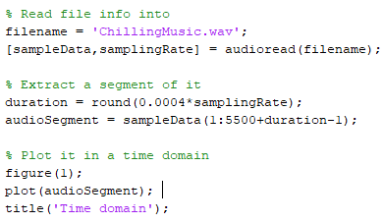
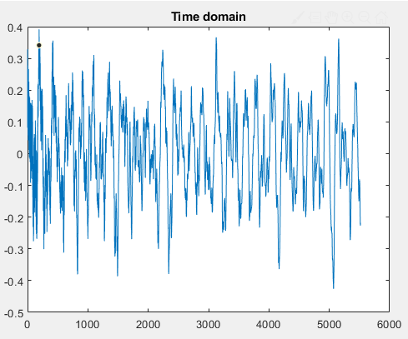
Getting .wav into time domain

Slide 4
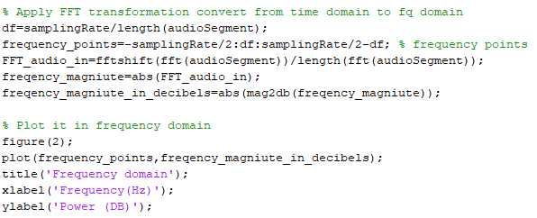
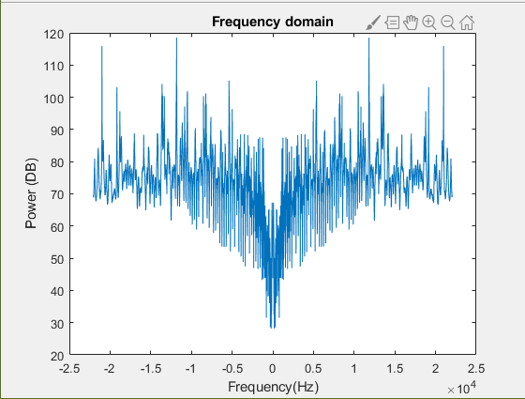
Converting to frequency domain

Slide 5
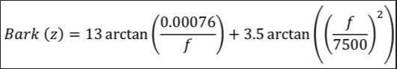
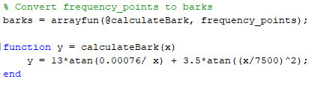
Calculating critical bands value

Slide 6
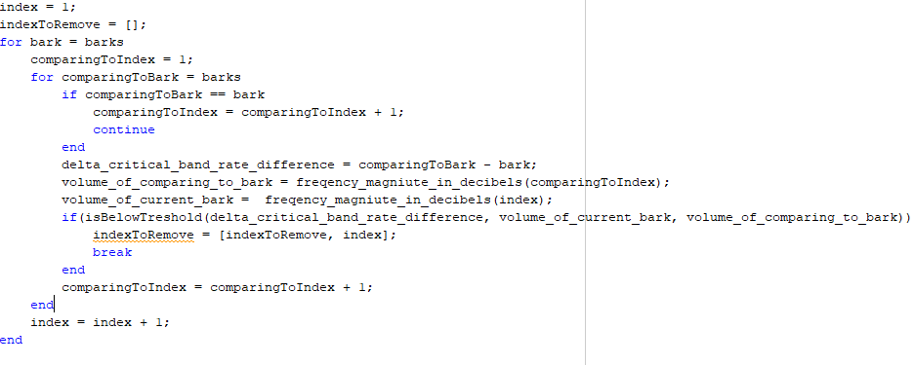
Calculating critical bands differences

Slide 7
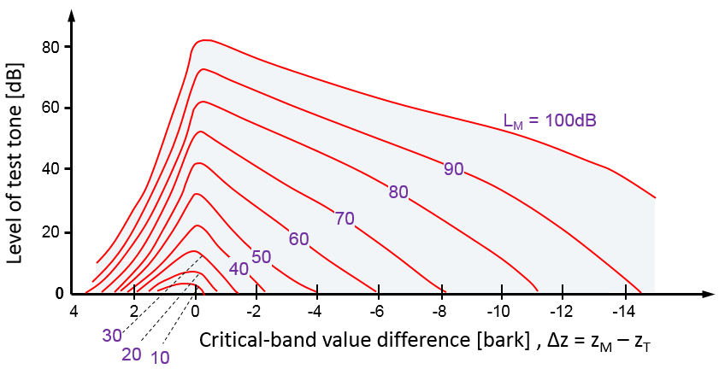
Is below threshold ?
Masking curves enables us to determinate if the tone will be masked

Slide 8
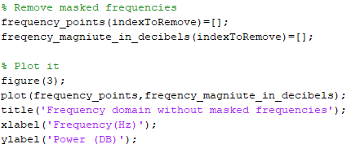
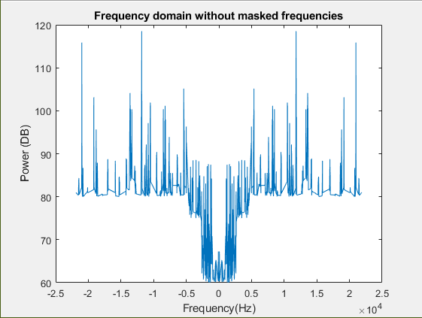
Remove masked and redraw

